Slide 1
LARIAT RENT-A-CAR
2019 fleet planning Business

Slide 2
2018 Summary
Fleet Type
4,000
Unit
81,318
Number of Rentals
325,608
Gross Revenue
$52,830,207
Net Revenue $19,753,518
Branch
50 Branch all over 23 states
Manufacture
73

Slide 3
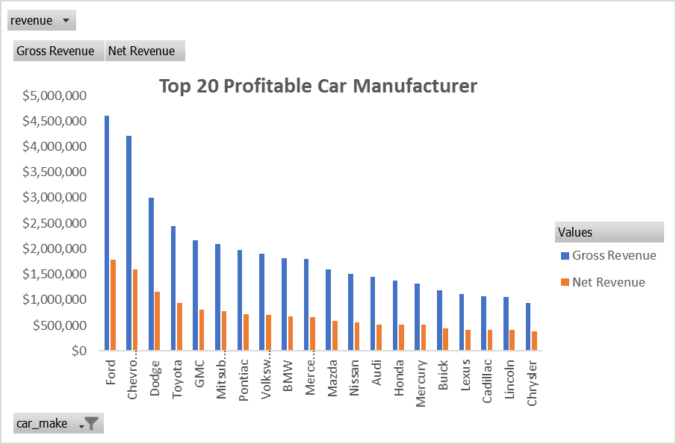

Slide 4
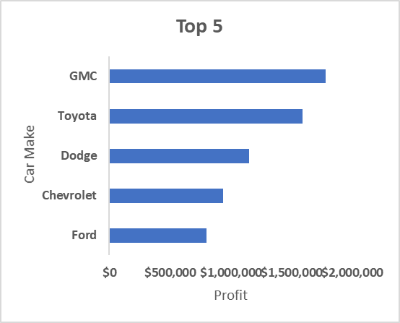
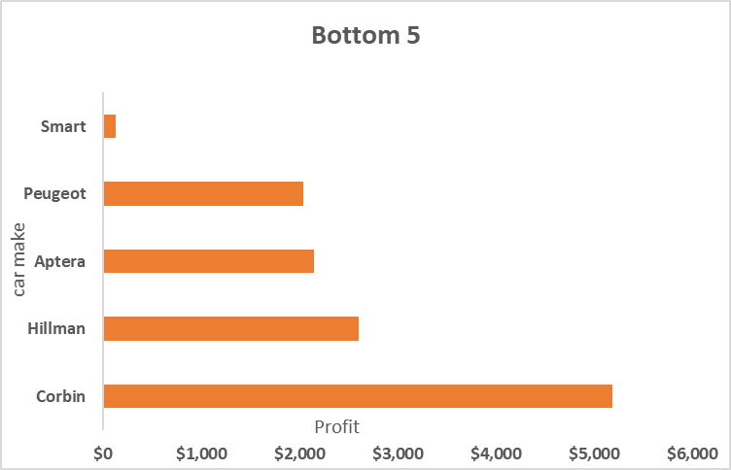
TOP AND BOTTOM 5 CAR MANUFACTURE

Slide 5
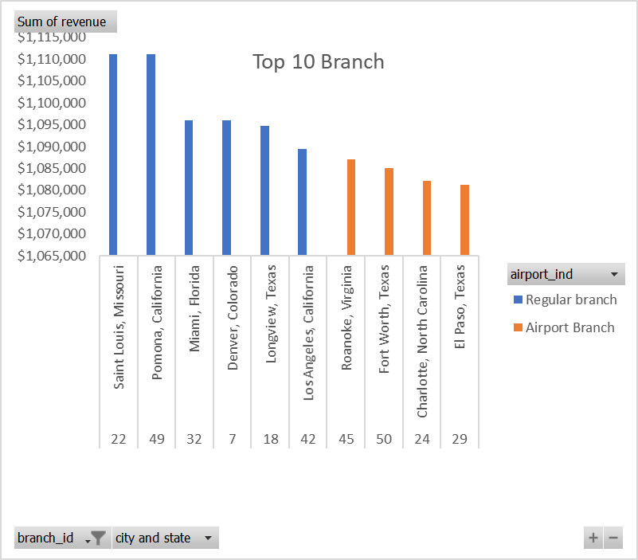

Slide 6
Strategy 1 : Eliminate the unprofitable car (unit)
assuming those cars with annual profit <$1000:unprofitable
Total Unit
81,318
Total Unit
80,940
Annual Cost $33,076,689
Annual Cost $29,615,586
Gross Revenue
$52,830,207
Gross Revenue
$ 49,484,192
1%
Profit
$19,753,518
Profit
$19,868,606
101%

Slide 7
Strategy 2 : Increase the rental price for 5%
Gross Revenue
$52,830,207
Gross Revenue $55,471,717
Profit
$19,753,518
Profit
$22,395,029
13%
113%

Slide 8
Strategy 3 : Reduce 10% of fleet cost (non insurance)
Annual Cost $33,076,689
Annual Cost $30,252,258
Profit
$19,753,518
Profit
$22,577,949
14%
114%

Slide 9
Combined Strategy 2 & 3 : Increase 5% rental price and reduce cost by 10%
Annual Cost $33,076,689
Annual Cost $30,252,258
Gross Revenue $52,830,207
Gross Revenue
$55,471,717
28%
Profit
$19,753,518
Profit
$25,219,459
128%

Slide 10

Increase the rental price 5% for each particular daily prices without exception while try to eliminate the cost at the maximum of 10%
PROPOSAL

Slide 11
Price incremental significantly will increase the revenues
Cost efficiency will also help to determined reallocation fund (such as procurement new units, chances of opening new branches, etc)
Est Cost -2.8 M
Est Revenue +$2.6 M
Est Profit +$5.5 M
ESTIMATED
IMPACT

